Slide 1
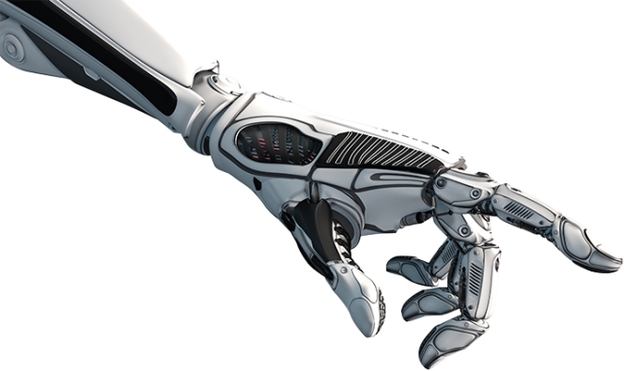
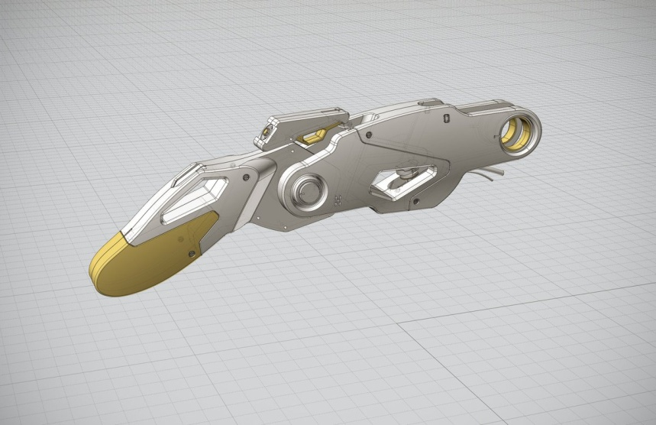
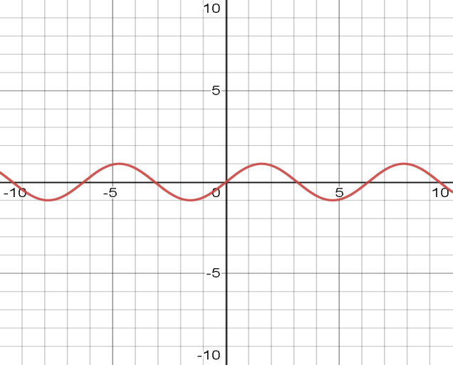
Robotics in-hand control by vibrations
Zohar Franco
Noam Nahum
Dr. Avishai sintov

